Slide 1
e
bh
h
ai_25458
08/07/2024

Slide 2
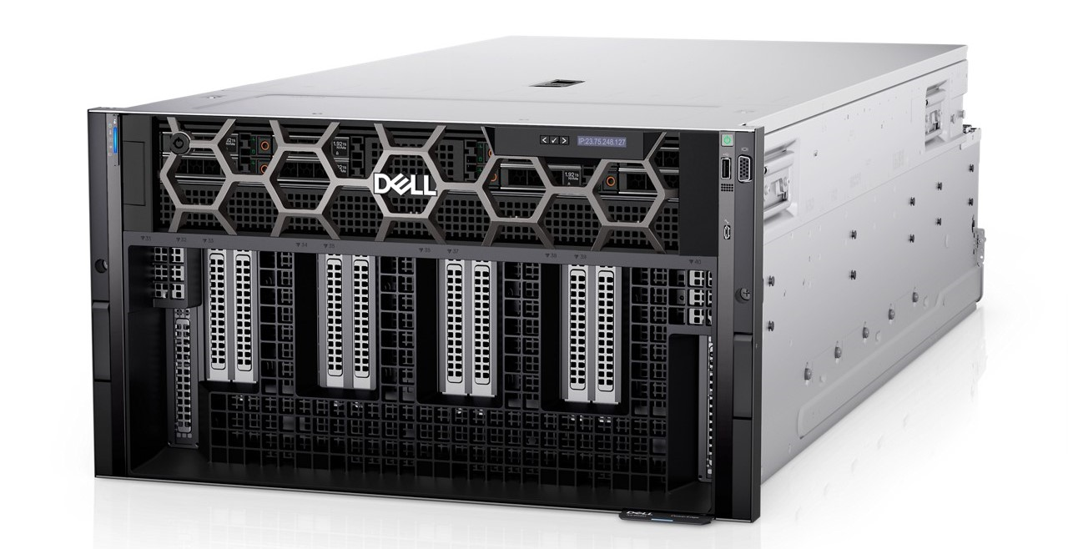
XE9680
4
6
Up to two 4th Generation Intel® Xeon® Scalable processors with up to 56 cores per processor
6U air-cooled, up to 35C ambient
1200mm rack capable
32 DDR5 DIMMs
4800 MT/s
NVIDIA 8 x H100 SXM5 700W 80GB GPUs
Full NVLINK interconnectivity
10 x 16 PCIe Gen5 slots
One OCP NIC 3.0
2 x 1GbE LOM
H100 SXM
8 GPU x 4 servers
80 GB
2560 GB
17.31

Slide 3
XE9680
Z9664F
1
2
Broadcom 57508
16
4 NIC x 4 servers
2:1
2x100GbE
8468 | 48 | 2.10
2
OPTIMIZED_BALANCED
32 | 4800
32
1024 GiB
8192 GiB
43296 W
10824 W
60312 W
15078 W

Slide 4
Sizing Input

Slide 5
Sizing Input
Generative AI
Training
SMALL(6B - 35B)
10
Data Center/Core
Large Language Model (Text)
Value
Broadcom 57508
NVIDIA
No

Slide 6
Other Solution Options

Slide 7
Other Solution Options
System | GPU | Estimated Training Time (days)
4 x XE9680 | 32 x H100 SXM | 17.31
8 x XE8640 | 32 x H100 SXM | 17.31
24 x R760XA | 96 x L40S | 13.92
48 x R760XA | 192 x L40S | 6.96
72 x R760XA | 288 x L40S | 4.64

Slide 8
Sizing Explanations & Notes

Slide 9
Sizing Explanations and Notes
In calculations for training times, the number of tokens is 300 billion.
Precision is FP16. TFLOPS assume sparsity.
Sizing Profile of “Value” yields a list of configurations that will have fewer servers and longer training times than other sizing profiles.
Sizing Profile of “Balanced” yields a list of configurations that will train in a reasonable amount of time.
Training time of the recommendations with a sizing profile of "High Performance" can be improved by adding more units.
At this time, the use of Multi-Instance GPUs (MIG) or slicing a GPU is not considered in the calculations for the number of GPUs recommended, the number of systems, or the time to train.
Time estimates assume no network bottlenecks or storage impediments.
Time estimates may not account for additional network overhead needed for communication across multiple clusters.
Additional optimization through both model specific tuning and framework/middleware changes may result in higher performance or lower memory usage
Power estimates are based on peak load and should be interpreted as maximum power guidelines (worst case scenario).
H100 NVBridge is a two-physical, single-logical GPU with twice the memory and compute capability of a single H100PCIe
AI training performance is better when the network bit rate is higher, therefore 200Gb/s ports are recommended for “best performance” or “balanced” scenarios.
Default is a selection of “no” to Include Liquid Cooling. If “yes” is selected, the configurations will include XE9640 server. It is a 2U Direct Liquid Cooled GPU server that requires a Cooling Distribution Unit.

Slide 10
Single switch (Z9664F – 100GbE Port Configuration)

